Slide 1

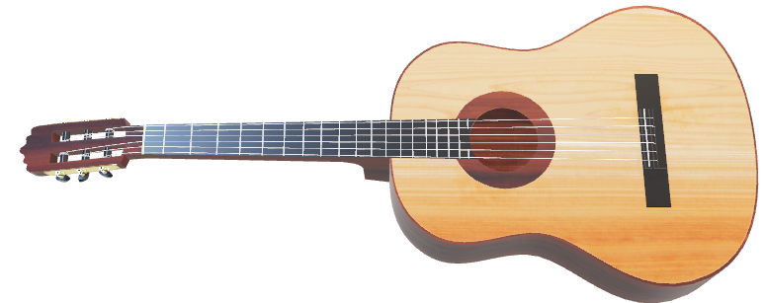
CHINOOK Project

Slide 2
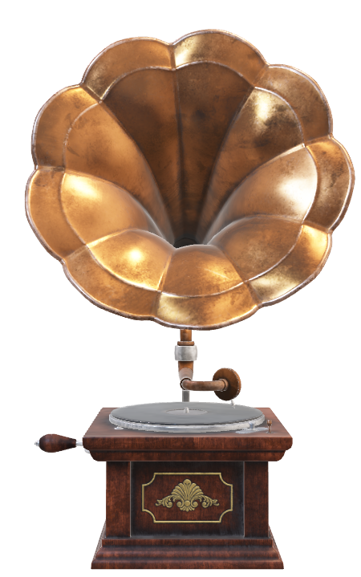
Agenda
Problem Statement – Business Goal
Data Schema
Data Description & Understanding
Data Cleaning
Data Analysis
Objective Key Metrics and Visualization
Subjective Question for Insights & Recommendations

Slide 3

Company Overview
Established in 1995, Chinook Music Service has been North Central Washington’s number one source for music instruments, accessories, band and orchestra rentals and repairs.
Our experienced, professional staff is dedicated to providing the highest level of support and product knowledge.
From school music programs to rock and roll bands, we are here to satisfy every need. Stop by and see how we can help you grow your skills and enjoy the many benefits of making music!
The Chinook Music Store Database which is used to provide the insights & recommendations
Please Visit: https://chinookmusic.com/about-us/

Slide 4
Problem Statement
You are hired as a data analyst at Chinook, and your objective is to analyze music record sales data to gain insights and make recommendations for the company's strategy in the physical music market

Slide 5
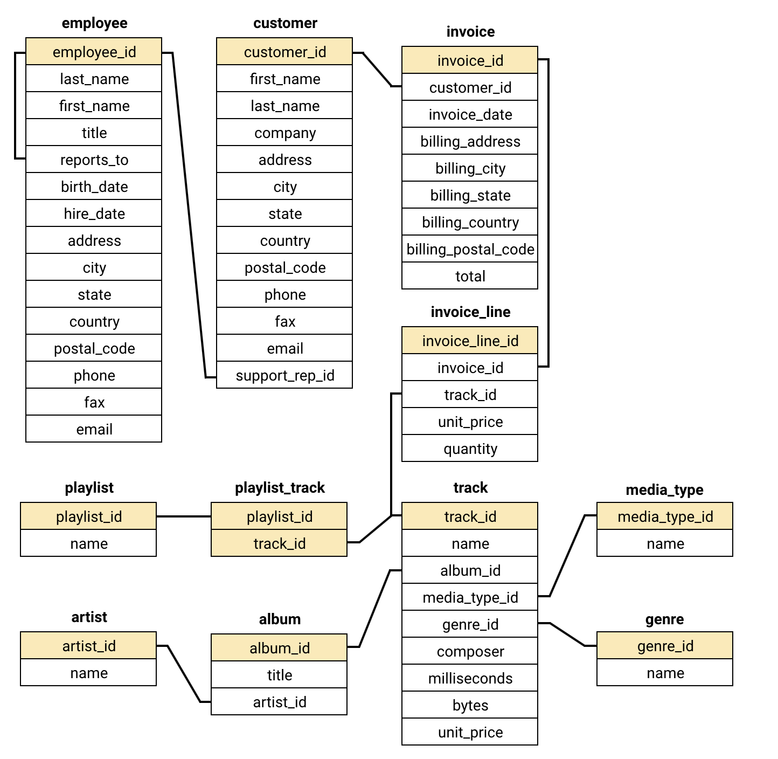
Database Schema

Slide 6
Database overview & Description
customer:
customer_id: Unique identifier assigned to each customer.
first_name: The given name or first name of a customer.
last_name: The surname or family name of a customer.
company: The name of the company associated with a customer.
address: The street address of a customer's location.
city: The city where a customer is located.
state: The state or province where a customer is located.
country: The country where a customer is located.
postal_code: The postal or zip code of a customer's address.
phone: The phone number of a customer.
fax: The fax number associated with a customer.
email: The email address of a customer.
support_rep_id: The employee ID of the support representative assigned to a customer.

Slide 7
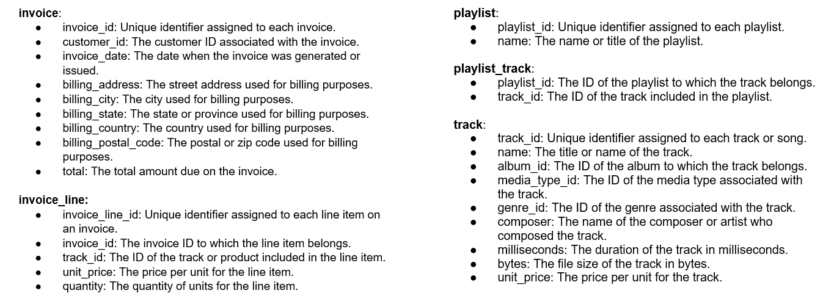
Database overview & Description

Slide 8
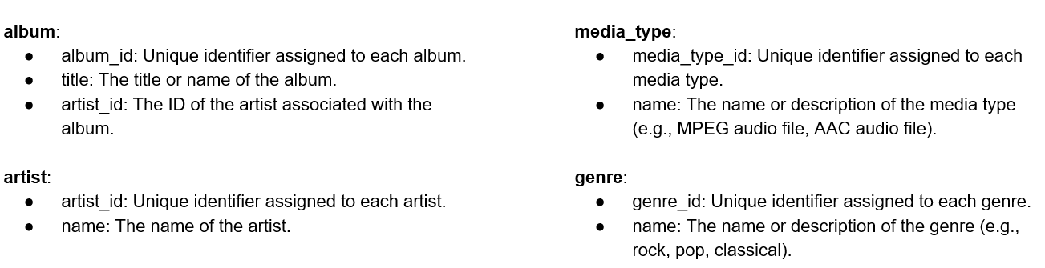
Database overview & Description
Data Link: Link

Slide 9
DATA Cleaning

Slide 10
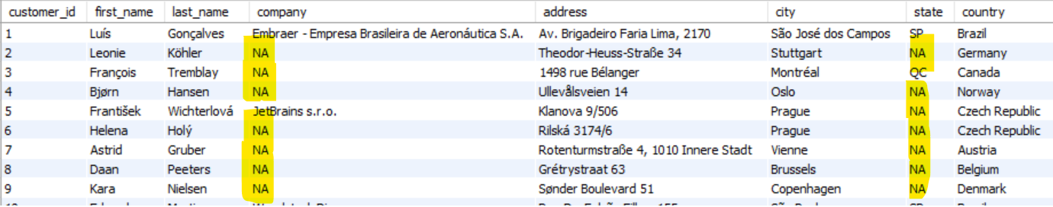
Database Cleaning
As there are multiple null or missing or empty values in database in the rows and columns which needs to be accurate for analysis
I have replaced those Null values using Coalesce function.
After replacing the null values I have created a view for the tables where the null values are existing and to recall for future reference as we can consider the NA for Null values
Ex: customer table the query is
create view customer_view as
select customer_id, first_name, last_name, coalesce(company, "NA") as company, coalesce(address, "NA") as address, city, coalesce(state, "NA") as state, country, coalesce(postal_code,"NA") as postal_code, coalesce(phone,"NA") as phone, coalesce(fax,"NA") as fax, email, support_rep_id from customer;

Slide 11
Analysis of data

Slide 12
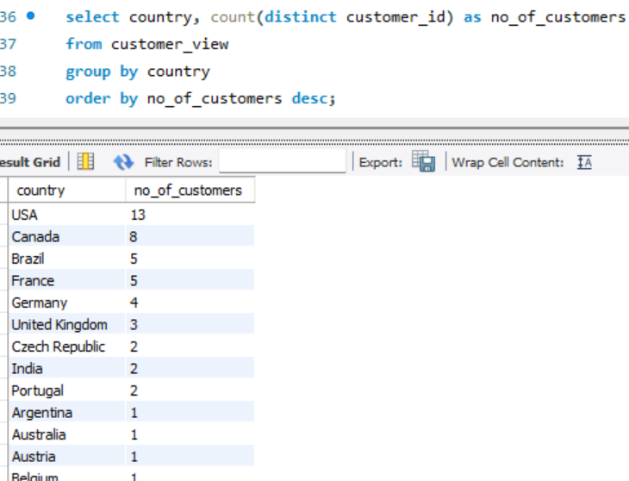
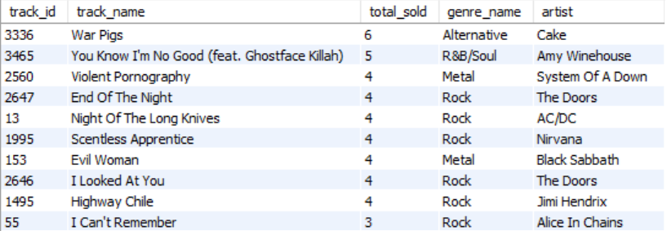
Database Analysis
Based on the countries the Majority of Customers are from USA (13 out of 59) around ~22% approx.
Most of the revenue is being generated from USA as it is having a greater number of customers.
The Most Popular genre is Rock in USA based on the sales & revenue generated by the customers
The Most Famous Genre is Rock where the top-most artist is The Doors with the track name as End of the Night and I Looked at You which generated from Rock genre

Slide 13
Top 5 Customers for Top 5 countries
Calculating the total revenue generated by each country to rank the countries group by state & city as it will give more details to check from country the customers are doing the more purchases and no of purchases made by each country
It will help us to understand which genre
is most popular among the countries as
it will help in the promotion campaigns or
for any marketing purposes
The Customer from Brazil has made the
highest revenue as they have placed more
Orders than any other customers from
Other regions

Slide 14
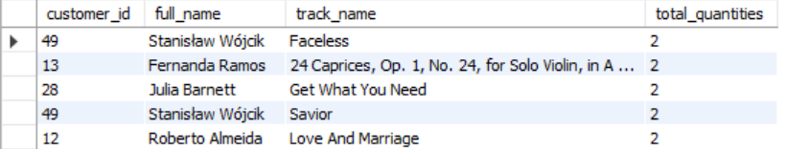
Top Tracks
The Faceless track was purchased by Stanisław Wójcik 2 times more than any other tracks
Where as Frantisek Wichterlova is the top most customer from city Prague has purchased highest no. of quantities 146 overall considering all the tracks and average order value of 11.11, followed by Helena Holý (10.73) and Robert Brown (10.15).

Slide 15
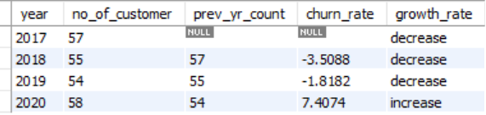
Churn rate analysis
Insights:
Though churn rate is very less and minimal and the highest churn_rate between 2017 and 2020 is 2018 with highest churn rate as -3.5 where we have seen some decrease in no_of_customer during these years
In 2020, there is increase in customers compared to the previous year
Recommendations:
Find the Root Cause for the customers who are not using or purchasing and try to meet the needs for them if can be done by delivering the content which is needed
Promote the customer engagement by giving free membership for the initial days as demo to make them aware of all the options available
Post free trail period suggest some offers or discount to
make them as permanent user it will correlates to the
Revenue genereation.

Slide 16
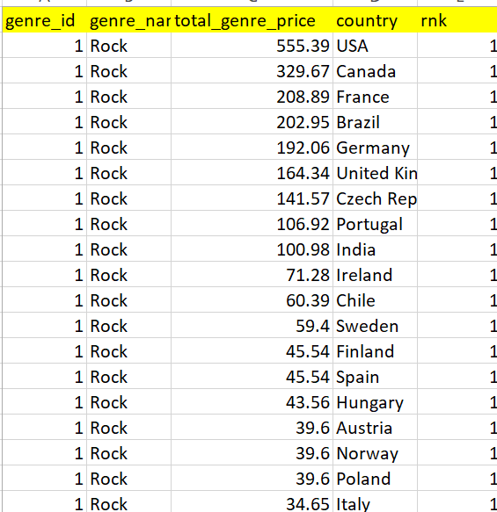
Top selling genres across the countries
Insights
Apart from Argentina all the other countries the Rock is most famous genre across all the countries considering it is one of the top 3 genres in all the regions
In USA the Rock genre is top most selling genre across the other genres
During the promotions or marketing or making a new album this factor can be considered as priority as the sales are sky high for this Rock genre
Recommendation
As the number of customers is less than 2 in Argentina the organization can focus on the customer by providing the required content and simultaneously the organization can be looked to increase their market in the Argentina to see the customer growth in all the regions if number of customer are less than 2

Slide 17
Top selling genres across the countries
Insights:
Across the regions the Rock genre has sold in large quanity and it is most popular genre across the regions
The Rock genre is correlated to the revenue as it gave more weightage to the revenue from customers
Apart from Rock genre, the Metal genre has pretty good record in Canada & Brazil which shows that those customers have a varied music taste and shown interest in different genres as they are showing the versatility in the music taste.
This shows that if any promotion or concert is happening in Brazil, they can perform the either Alternative & Punk or Metal which will be correlates to the revenue growth in the particular regions
Recommendations:
In most of the countries Rock genre has given priority so it is a soft signal for artists as they can compose more on Rock genre or a mix with Rock genre which will eventually increase the Revenue

Slide 18
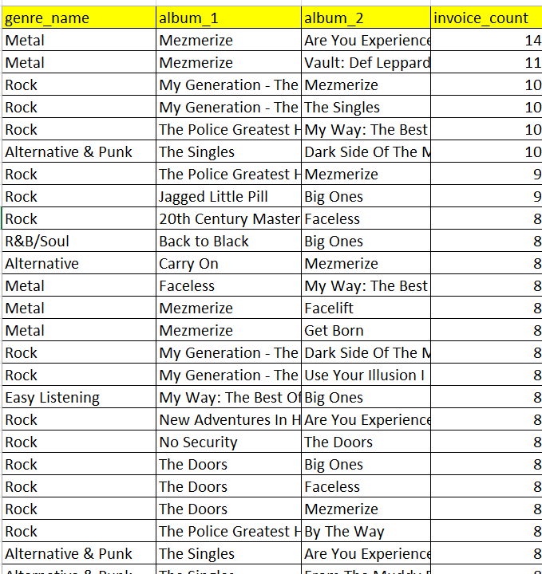
Product Affinity -Albums purchased together
Insights:
The Rock genre has been purchased by most of the customers along with the other genres with the purchase counts
Where Mezmerize is top most album purchased with popular album paired with several others combination of another album
Recommendation:
We can start promoting the Rock & Metal in the ads, banners or start promoting these genres while purchasing the albums.
Special Editions: Create box sets with frequently paired albums to attract collectors with some unique offers.
Curated Collections: Create and market "Perfect Pairings" or "Ultimate Combo Packs" based on genre and artist affinities.

Slide 19
Customer purchasing behaviour
Insights
Customer Purchase behaviour is categorized as Long-Term & Short-Term
As we have data from 2017-2021 if the customer is not active more than 1000 days out of data provided 4 years then the customer is categorized into the Long-Term or else the Short-Term
The average price per customer or average purchase frequency is greater in all aspects for Long-Term when to compared to Short-Term
Recommendation: Considering this the customers can be seasonal discounts and annual discounts to keep them engaging and active.
Long-Term
Short-Term

Slide 20
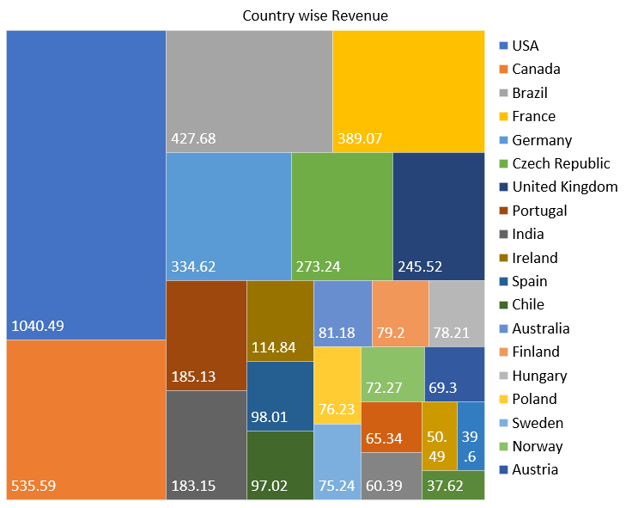
Customer purchasing behaviour
Insights
Customer based out of USA purchased more compared to other regions as it is showing approx ~20% of overall revenue
As people in USA likes ROCK and followed by Candan & Brazil have varied taste in the genres as they like Metal & Alternative
Recommendation: Considering the above conditions it is decided if promotions are happening in USA the genre can be ROCK
If promotions are happening in Brazil & Canada the Metal & Alternative genres can be prioritized
This should be considered while artists working on genres as they are composing to be released according to the countries which are prioritized with respective popular genres in the country

Slide 21
Customer purchasing behaviour
Insights
Customers in Czech Republic, Ireland, and Spain spend the most on average.
India and Brazil are considered as emerging as the revenue is being generated from these countries are gradually increasing
Argentina, Denmark, and Italy have customers spending the least.
Recommendation:
Start rolling out the offers to the customers falling under New category or annual packages with offers to convert them into Long-Term Category
Referrals can be used and once the reference is used some membership points can be provided for both old & new customers to keep them engaging by adding some perks & benefits which can be used for next purchase or any coupons for shopping can be used.

Slide 22

Growth strategy
Recommendations:
As there is much churn rate indicating the customers are likely to not be renew their purchases
The seasonal discounts can be provided or quarterly or annually to keep the customers engaging
As revenue is concerned the artists can focus on composing the albums and countries that top genre is likely similar to keep them engaging and market of the genre which will increase the revenue

Slide 23
Conclusion
Major Revenue Sources:
The majority of revenue is generated from the USA, Brazil, and Canada.
Top Performing Genres:
Rock and Metal emerge as the most popular genres and should be prioritized in promotional strategies.
Customer Engagement:
Approximately 29% of customers have not made recent purchases, highlighting the need for timely re-engagement initiatives.
Churn Challenges:
Countries such as Germany and Norway exhibit higher churn rates, indicating potential areas for targeted retention efforts.
Retention of High-Value Customers:
High-spending customers are not consistently retained, suggesting improvements are needed in loyalty and rewards programs.
Need for Personalization:
Personalized and region-specific marketing campaigns are essential to remain competitive in the physical music market.

Slide 24

Thank you

